Slide 1
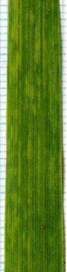
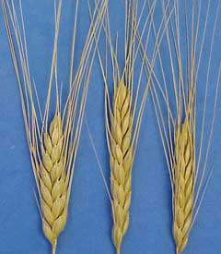
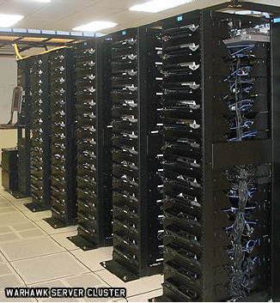
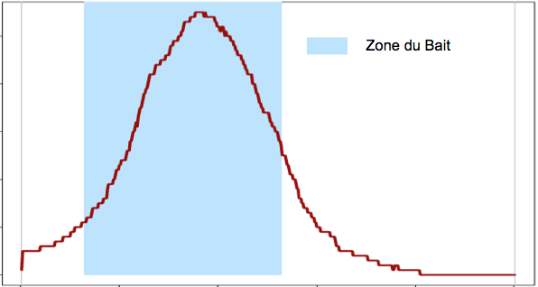
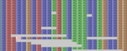




Ecological Genomic of Tetraploïd Wheat Domestication Tunis, Septembre 2015
Authors : Y. Holtz, T. Gioia, J. David, R. Papa

Slide 2
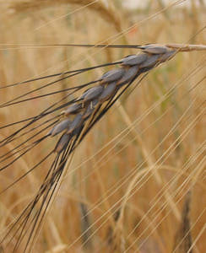
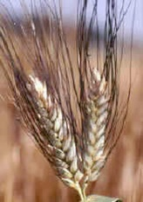
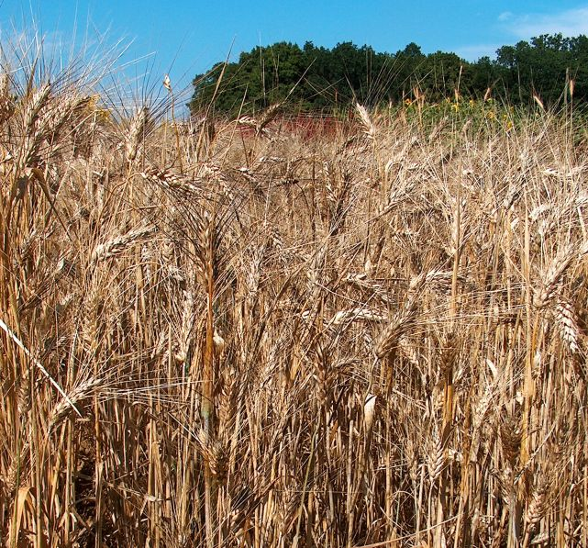
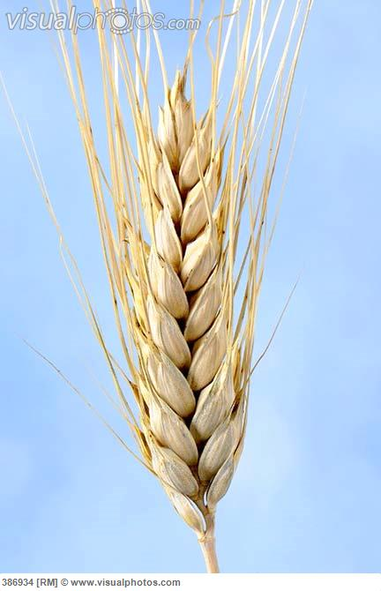
Introduction
Evolution of tetraploid turgidum wheat (2x=4x=28)
Primary Domestication
Secondary Domestication
T. durum
(durum wheat)
T. dicoccoides
(wild emmer)
T. dicoccum
(domestic emmer)
Landraces
Modern varieties
Brittle rachis,
hulled grain
2 kernels/spikelet
Non brittle rachis,
hulled grain
2 kernels/spikelet
Non brittle rachis,
necked grain
Large grain
>2 grains per spikelet
Semi dwarf
Non brittle rachis,
necked grain
Large grain
>2 grains per spikelet

Slide 3
Phenotyping
Introduction
GROWSCREEN-Rhizo phenotyping robot
Notes:
Voici la définition trouvé sur le web.
On voit donc que la bioinfo regroupe plein de thématique. Un bioinfo ne les connaît pas toutes.
Mais alors comment définir de maniere générale ?
Interface entre biologie et informatique. Car dans certains cas les données sont trop grandes.
On utilise donc un ordi !
Le pls souvent, ce sont des NGS → Impossible sans un ordi !

Slide 4
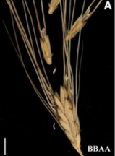
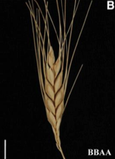
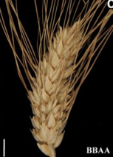
Material and Method
Dicoccoides
12 genotypes
Dicoccum
12 genotypes
Durum
12 genotypes
36 genotypes
X 2 Conditions
- High Nitrogen
- Low Nitrogen
143 samples
X 2 Repetitions

Slide 5
Material and Method
Questions ??
Do we have a genetic structure between Dicoccoides, Dicoccum and Durum?
Do we have a loss of genetic diversity from Dicoccoides to Durum ? How can we quantify it ?
Do we have a structure of the populations concerning the patterns of expression ?
Difference between sub species concerning the adaptation to Nitrogen ?

Slide 6
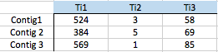
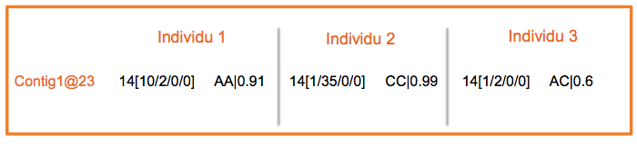
Material and Method
RNA extraction + sequencing
Sample 1
Sample 2
Sample 3
Mapping (bwa aln)
Contig 1
Bread Wheat Reference (IWGSC)
Contig 2
Contig 3
Reads Counts
SNP detection

Slide 7
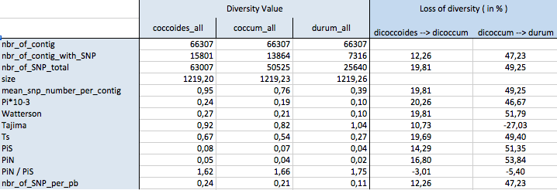
Result : loss of diversity ??
Loss of diversity ?
~ 15% loss between Dicoccoides and Dicoccum
~ 45% loss between Dicoccum and Durum !

Slide 8
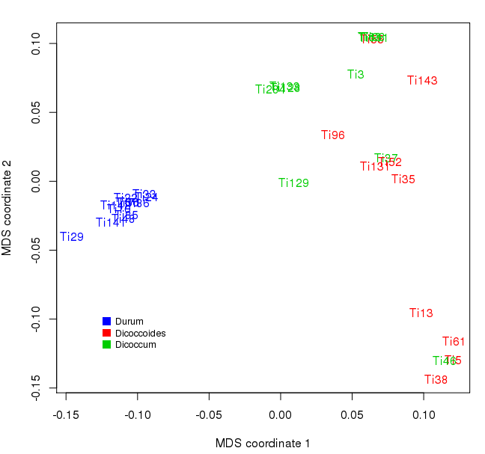
Result : loss of diversity ??
Nucleotidic Structure ?
Strong Structure
Durum is really distinct and has less genetic diversity

Slide 9
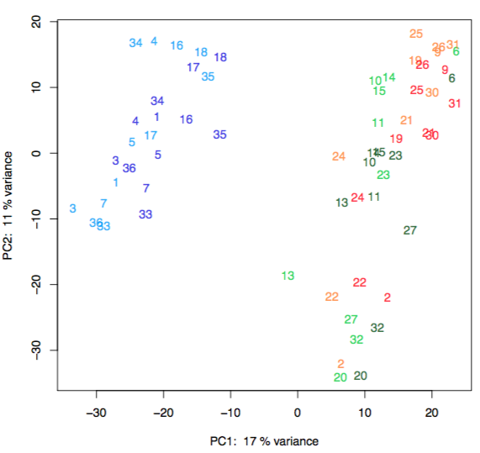
Result : loss of diversity ??
Structure using genes expression ?
→ Same kind of structure for High And for Low Nitrogen
Durum does not express the same genes than Dicoccoides and Dicoccum
Less diversity in Durum patterns

Slide 10
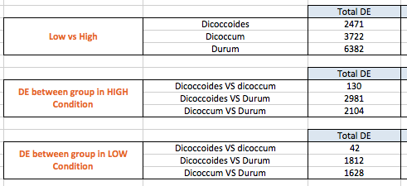
Result : loss of diversity ??
Differences between Nitrogen levels ?
Research of genes that are differentially expressed between expression / species
More differences between low and high for Durum !
Almost no difference between Dicoccoides and Dicoccum
→ Durum has been selected for High Nitrogen conditions !

